Slide 1
Hi.
Everything for this workshop is available online here https://github.com/nd1/women_in_tech_summit_DC2017
(This presentation is best viewed online.)

Slide 2
Accessing APIs with Python
Nicole Donnelly
The Women in Technology Summit, Washington DC 2017

Slide 3
Who Are You?
How many people know python?
How many people have used RSS?
How many people have used APIs?

Slide 4
Who Am I?
I really love data.
I work for DC.

Slide 5
Agenda
An Overview
What are APIs?
Where are APIs?
How do I access APIs?
What is the API giving me?
Hands-on
RSS (notebook)
REST APIs with Authentication (notebook)
Scripting API Calls (script)

Slide 6
What are APIs?
Application Programming Interface
“In the simplest terms, APIs are sets of requirements that govern how one application can talk to another.”
“APIs are what make it possible to move information between programs....”
Source: http://readwrite.com/2013/09/19/api-defined

Slide 7

Where are APIs?

Slide 8
What is RSS?
RSS
“RSS is an XML-based vocabulary for distributing Web content in opt-in feeds. Feeds allow the user to have new content delivered to a computer or mobile device as soon as it is published. ”
Source: http://searchwindevelopment.techtarget.com/definition/RSS

Slide 9
Is RSS an API?

Slide 10
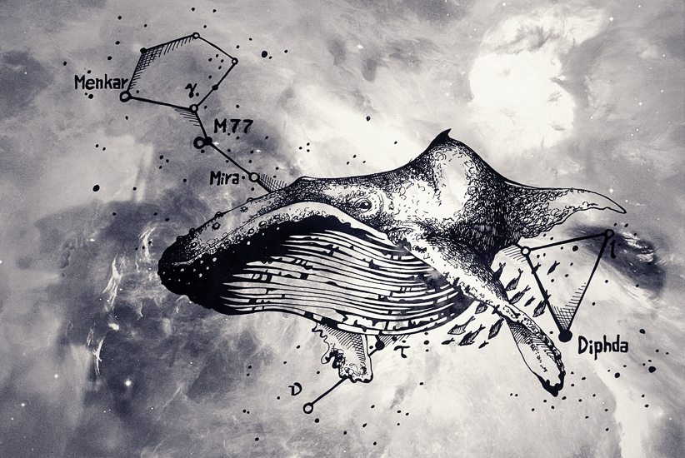
"Space Whale" by hbitik is licensed under CC BY-NC-ND 3.0
Baleen

Slide 11
How do I access RSS and APIs?
Context: I will focus on RSS and REST APIs with JSON. Read more about API types here
RSS
http://dvd.netflix.com/NewReleasesRSS
<?xml version="1.0" encoding="UTF-8" standalone="yes"?> <rss version="2.0" xmlns:atom="http://www.w3.org/2005/Atom" > <channel > <title>New Releases This Week</title> <ttl>10080</ttl> <link>http://dvd.netflix.com</link> <description>New movies at Netflix this week</description> <language>en-us</language> <cf:treatAs xmlns:cf="http://www.microsoft.com/schemas/rss/core/2005">list</cf:treatAs> <atom:link href="http://dvd.netflix.com/NewReleasesRSS" rel="self" type="application/rss+xml"/> <item> <title>Bakery in Brooklyn</title> <link>https://dvd.netflix.com/Movie/Bakery-in-Brooklyn/80152426</link> <guid isPermaLink="true">https://dvd.netflix.com/Movie/Bakery-in-Brooklyn/80152426</guid> <description><a href="https://dvd.netflix.com/Movie/Bakery-in-Brooklyn/80152426"><img src="//secure.netflix.com/us/boxshots/small/80152426.jpg"/></a><br>Vivien and Chloe have just inherited their Aunt's bakery, a boulangerie that has been a cornerstone of the neighborhood for years. Chloe wants a new image and product, while Vivien wants to make sure nothing changes. Their clash of ideas leads to a peculiar solution, they split the shop in half. But Vivien and Chloe will have to learn to overcome their differences in order to save the bakery and everything that truly matters in their lives.</description> </item>

Slide 12
Context: I will focus on RSS and REST APIs with JSON. Read more about API types here.
API
http://dev.markitondemand.com/Api/Quote/json?symbol=AAPL
{"Data":{"Status":"SUCCESS","Name":"Apple Inc","Symbol":"AAPL","LastPrice":117.12,"Change":-0.349999999999994,"ChangePercent":-0.297948412360598,"Timestamp":"Wed Oct 19 00:00:00 UTC-04:00 2016","MarketCap":631094444160,"Volume":20034594,"ChangeYTD":105.26,"ChangePercentYTD":11.2673380201406,"High":117.76,"Low":113.8,"Open":117.25}}

Slide 13
http://api.dp.la/v2/items?api_key=0123456789&q=goats+AND+cats
{"count":29, "start":0, "limit":10, "docs":[{"@context":"http://dp.la/api/items/context","isShownAt":"http://cdm16795.contentdm.oclc.org/cdm/ref/collection/divtour/id/88","dataProvider":"Missouri State Archives through Missouri Digital Heritage","@type":"ore:Aggregation","provider":{"@id":"http://dp.la/api/contributor/missouri-hub","name":"Missouri Hub"},"hasView":{"@id":"http://cdm16795.contentdm.oclc.org/cdm/ref/collection/divtour/id/88"},"object":"http://data.mohistory.org/files/thumbnails/cdm16795_contentdm_oclc_org568ad334407e0.jpg","ingestionSequence":12,"id":"9e05f398ca95f9bbfd733e6d3493fd74","ingestDate":"2016-10-11T13:21:48.399681Z","_rev":"7-6bee4d18708d1d16efceeea1e061b316","aggregatedCHO":"#sourceResource","_id":"missouri--urn:data.mohistory.org:mdh_all:oai:cdm16795.contentdm.oclc.org:divtour/88","sourceResource":{"title":["Alabama Big Cats Safari Adventure"],"description":["Children bottle feeding goats"],"subject":[{"name":"Transparencies, Slides"},{"name":"Tourist Destination"}],"rights":["Copyright is in the public domain. Items reproduced for publication should carry the credit line: Courtesy of the Missouri State Archives."],"relation":["Division of Tourism Photograph Collection"],"language":[{"iso639_3":"eng","name":"English"}],"format":"Image","collection":{"id":"594a2b3666ab0c55245f6640555554cd","description":"","title":"Mdh_divtour","@id":"http://dp.la/api/collections/594a2b3666ab0c55245f6640555554cd"},"stateLocatedIn":[{"name":"Missouri"}],"@id":"http://dp.la/api/items/9e05f398ca95f9bbfd733e6d3493fd74#sourceResource","identifier":["001_070","http://cdm16795.contentdm.oclc.org/cdm/ref/collection/divtour/id/88"],"creator":["GD"]},"admin":{"validation_message":null,"sourceResource":{"title":"Alabama Big Cats Safari Adventure"},"valid_after_enrich":true},"ingestType":"item","@id":"http://dp.la/api/items/9e05f398ca95f9bbfd733e6d3493fd74","originalRecord":{"id":"urn:data.mohistory.org:mdh_all:oai:cdm16795.contentdm.oclc.org:divtour/88","provider":{"@id":"http://dp.la/api/contributor/missouri-hub","name":"Missouri Hub"},"collection":{"id":"594a2b3666ab0c55245f6640555554cd","description":"","title":"mdh_divtour","@id":"http://dp.la/api/collections/594a2b3666ab0c55245f6640555554cd"},"header":{"expirationdatetime":"2016-10-08T17:04:17Z","datestamp":"2016-10-04T13:19:05Z","identifier":"urn:data.mohistory.org:mdh_all:oai:cdm16795.contentdm.oclc.org:divtour/88","setSpec":"mdh_divtour"},"metadata":{"mods":{"accessCondition":"Copyright is in the public domain. Items reproduced for publication should carry the credit line: Courtesy of the Missouri State Archives.","location":{"url":[{"#text":"http://cdm16795.contentdm.oclc.org/cdm/ref/collection/divtour/id/88","access":"object in context"},{"#text":"http://data.mohistory.org/files/thumbnails/cdm16795_contentdm_oclc_org568ad334407e0.jpg","access":"preview"}]},"subject":[{"topic":"Transparencies, Slides"},{"topic":"Tourist Destination"}],"name":{"namePart":"GD","role":{"roleTerm":"creator"}},"relatedItem":{"titleInfo":{"title":"Division of Tourism Photograph Collection"}},"physicalDescription":{"note":"Image"},"xmlns":"http://www.loc.gov/mods/v3","language":{"languageTerm":"eng"},"titleInfo":{"title":"Alabama Big Cats Safari Adventure"},"identifier":["001_070","http://cdm16795.contentdm.oclc.org/cdm/ref/collection/divtour/id/88"],"note":["Children bottle feeding goats",{"#text":"Missouri State Archives through Missouri Digital Heritage","type":"ownership"}]}}},"score":4.534843}, ... "facets":[]}

Slide 14
What is the API giving me?
http://dev.markitondemand.com/Api/Quote/json?symbol=AAPL
{"Data":{"Status":"SUCCESS","Name":"Apple Inc","Symbol":"AAPL","LastPrice":117.06,"Change":-0.0600000000000023,"ChangePercent":-0.0512295081967233,"Timestamp":"Thu Oct 20 00:00:00 UTC-04:00 2016","MarketCap":630771137580,"Volume":24059570,"ChangeYTD":105.26,"ChangePercentYTD":11.2103363100893,"High":117.38,"Low":116.33,"Open":116.86}}
http://dev.markitondemand.com/Api/Quote/xml?symbol=AAPL
<QuoteApiModel> <Data> <Status>SUCCESS</Status> <Name>Apple Inc</Name> <Symbol>AAPL</Symbol> <LastPrice>117.06</LastPrice> <Change>-0.06</Change> <ChangePercent>-0.0512295082</ChangePercent> <Timestamp>Thu Oct 20 00:00:00 UTC-04:00 2016</Timestamp> <MarketCap>630771137580</MarketCap> <Volume>24059570</Volume> <ChangeYTD>105.26</ChangeYTD> <ChangePercentYTD>11.2103363101</ChangePercentYTD> <High>117.38</High> <Low>116.33</Low> <Open>116.86</Open> </Data> </QuoteApiModel>

Slide 15
Workshop
Please download the notebooks to try this out.
RSS (notebook)
REST APIs with Authentication (notebook)
Scripting API Calls (script)

Slide 16
Resources
Command Line
Command Line Crash Course - *nix based users (Linux/ OS X)
Effective Windows PowerShell - Windows users
Git and GitHub
There are a lot of online resources for using Git and GitHub. Here is a good one to start with An Intro to Git and GitHub for Beginners (Tutorial).

Slide 17
Resources
Python
There are a lot of Python references available. I used Learn Python the Hard Way and Automate the Boring Stuff with Python when I was first learning. I like the challenges on HackerRank to practice. The discussion on each challenge is great for seeing how other people approach the problem and to ask questions. The free beginner lesson on DataQuestare also great if you are just starting out or want more practice.

Slide 18
Stay in touch!
Twitter: @NicoleADonnelly
GitHub: nd1
LinkedIn: nicoleadonnelly
Email: Nicole Donnelly

